Slide 1
Graph Generation
Junhong Wan

Slide 2
GraphRNN: A Deep Generative Model for Graphs
GraphRNN: Generating Realistic Graphs with Deep Auto-regressive Models
Jiaxuan You · Rex (Zhitao) Ying · Xiang Ren · Will Hamilton · Jure Leskovec
2018 ICML Oral

Slide 3
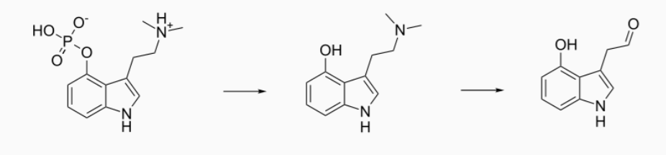
Introduction: Generative Model for Graphs
Modeling graphs is fundamental for studying networks
e.g. medical, chemical, social
Goal:
Model and efficiently sample complex distributions over graphs
Learn generative model from observed set of graphs

Slide 4
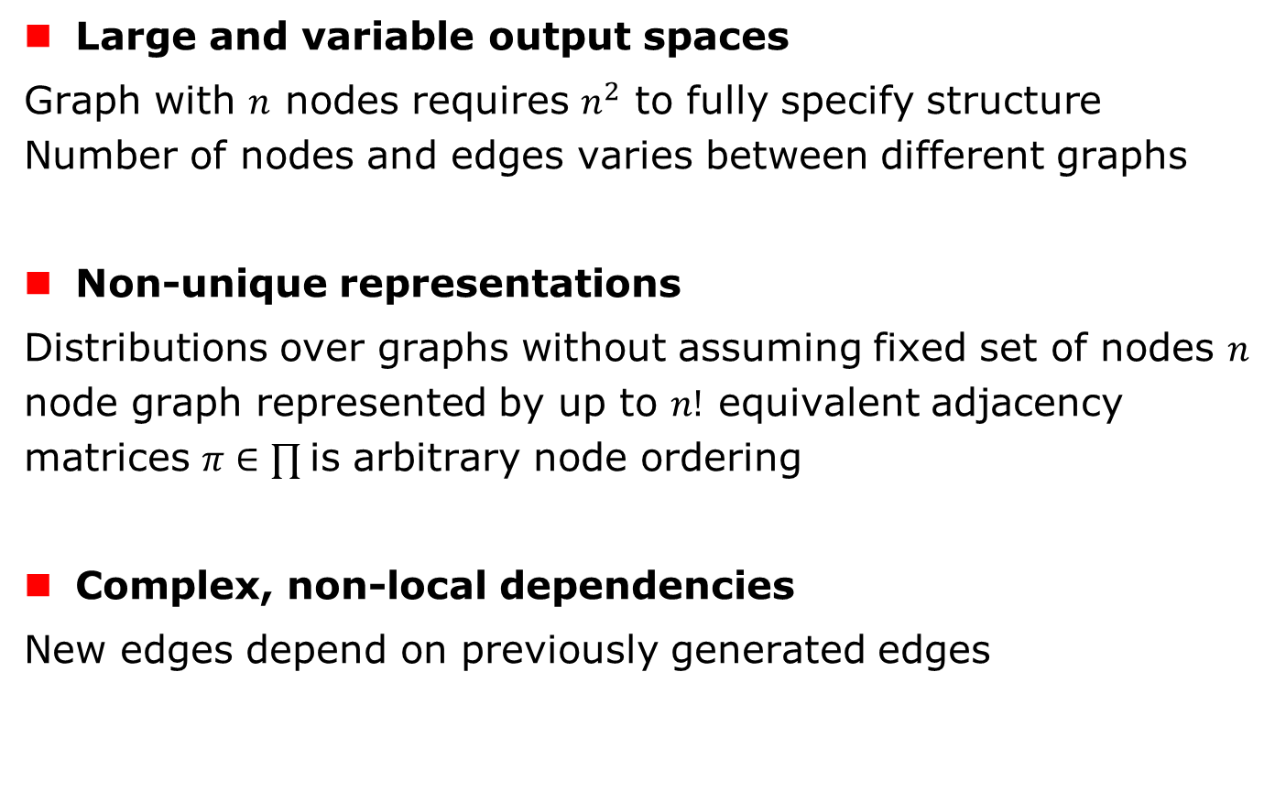
Challenges in Graph Generation
Large and variable output spaces
Graph with $n$ nodes requires $n^{2}$ to fully specify structure Number of nodes and edges varies between different graphs
Non-unique representations
Distributions over graphs without assuming fixed set of nodes $n$ node graph represented by up to $n!$ equivalent adjacency matrices $π∈∏$is arbitrary node ordering
Complex, non-local dependencies
New edges depend on previously generated edges

Slide 5
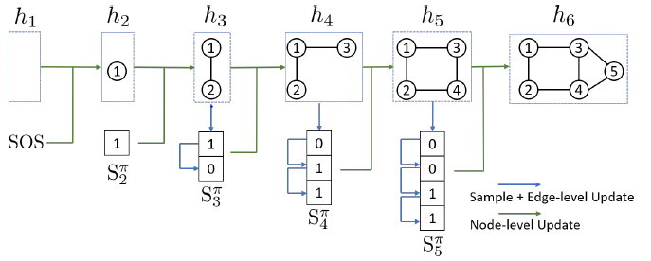
Overview to GraphRNN
Decompose graph generation into two RNNs:
Graph-level: generates sequence of nodes
Edge-level: generates sequence of edges for each new node

Slide 6
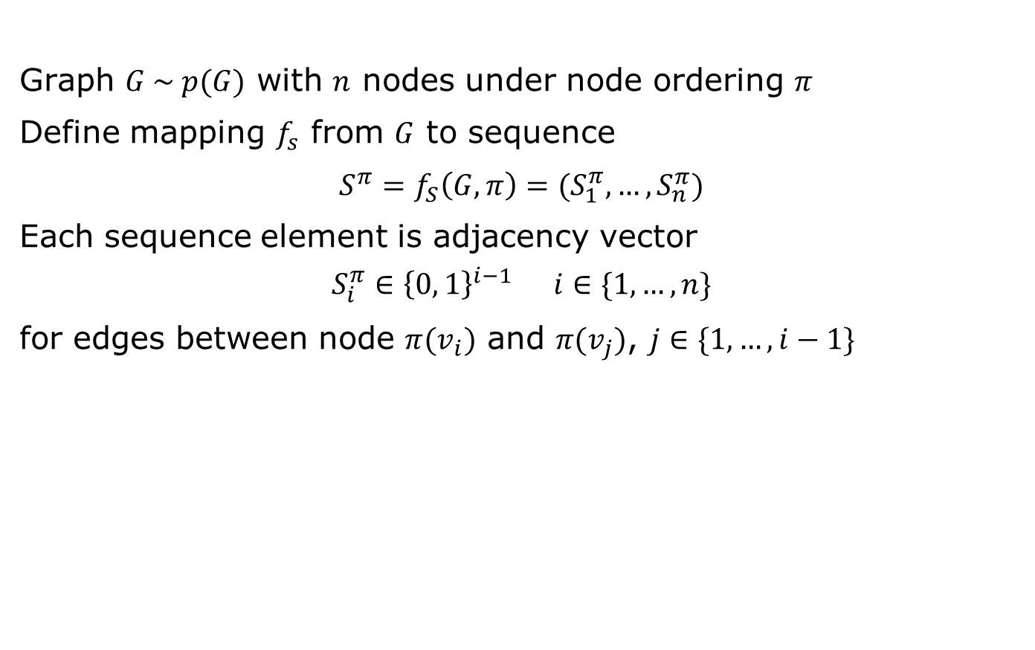
Modeling Graphs as Sequences
Graph $G \sim p(G)$ with $n$ nodes under node ordering $π$
Define mapping $f_{s}$ from $G$ to sequence
$S^{π}=f_{S}\left(G, π\right)=(S_{1}^{π}, …,S_{n}^{π})$
Each sequence element is adjacency vector
$$S_{i}^{π}∈{\left\{0, 1\right\}}^{i−1} i∈\{1,…,n\}$$
for edges between node $π(v_{i})$ and $π(v_{j})$, $j∈\{1,…,i−1\}$

Slide 7
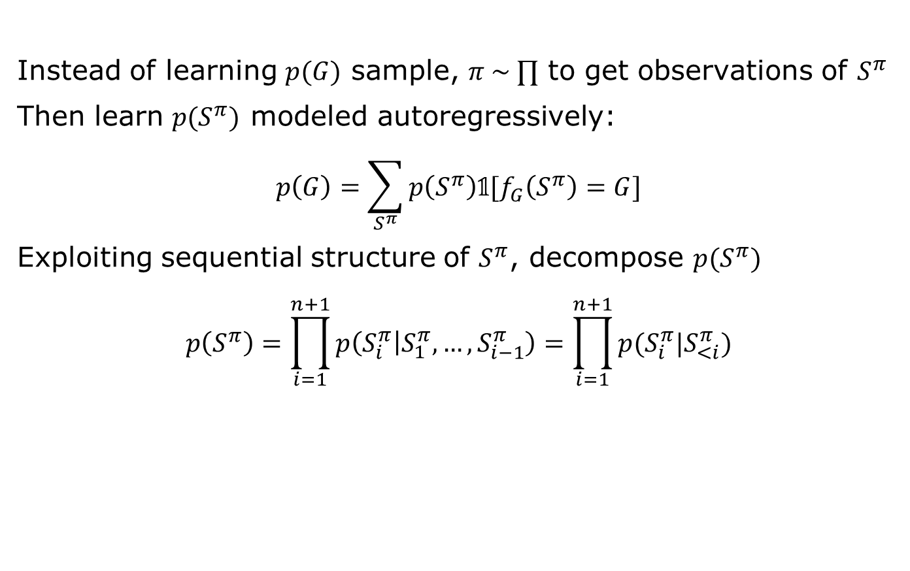
Distribution on Graphs --> on Sequence
Instead of learning $p(G)$ sample, $π \sim ∏$ to get observations of $S^{π}$
Then learn $p(S^{π})$ modeled autoregressively:
$$p\left(G\right)=\sum_{S^{π}}{p\left(S^{π}\right)𝟙[f_{G}\left(S^{π}\right)=G]}$$
Exploiting sequential structure of $S^{π}$, decompose $p(S^{π})$
$$p\left(S^{π}\right)=\prod_{i=1}^{n+1}{p\left(S_{i}^{π} | S_{1}^{π},…,S_{i−1}^{π}\right)}=\prod_{i=1}^{n+1}{p(S_{i}^{π}|S_{<i}^{π})}$$

Slide 8
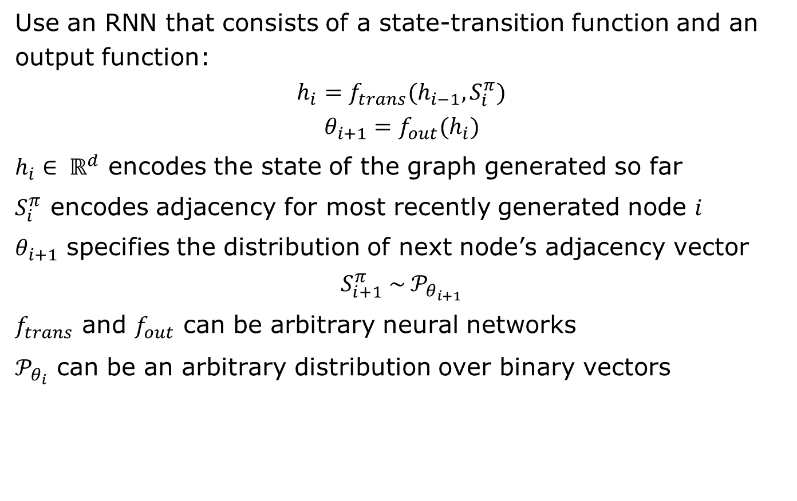
GraphRNN Framework
Use an RNN that consists of a state-transition function and an output function:
$$h_{i}=f_{trans}(h_{i−1}, S_{i}^{π})$$
$$θ_{i+1}=f_{out}(h_{i})$$
$h_{i}∈ ℝ^{d}$ encodes the state of the graph generated so far
$S_{i}^{π}$ encodes adjacency for most recently generated node $i$
$θ_{i+1}$ specifies the distribution of next node’s adjacency vector
$$S_{i+1}^{π} \sim 𝒫_{θ_{i+1}}$$
$f_{trans}$ and $f_{out}$ can be arbitrary neural networks
$𝒫_{θ_{i}}$ can be an arbitrary distribution over binary vectors

Slide 9
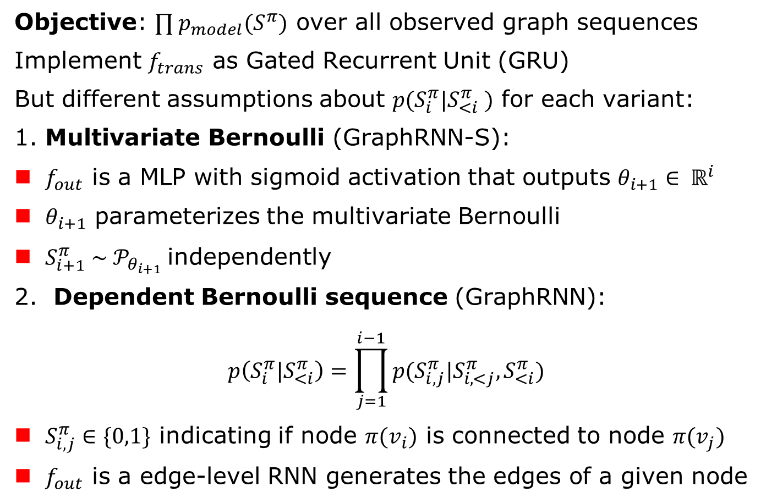
GraphRNN Variants
Objective: $∏{ p}_{model}(S^{π})$ over all observed graph sequences
Implement $f_{trans}$ as Gated Recurrent Unit (GRU)
But different assumptions about $p(S_{i}^{π}|S_{<i}^{π} )$ for each variant:
1. Multivariate Bernoulli (GraphRNN-S):
$f_{out}$ is a MLP with sigmoid activation that outputs $θ_{i+1}∈ ℝ^{i}$
$θ_{i+1}$ parameterizes the multivariate Bernoulli
$S_{i+1}^{π} \sim 𝒫_{θ_{i+1}}$independently
2. Dependent Bernoulli sequence (GraphRNN):
$$p\left(S_{i}^{π}|S_{<i}^{π}\right)=\prod_{j=1}^{i−1}{p(S_{i,j}^{π}|S_{i,<j}^{π}, S_{<i}^{π})}$$
$S_{i,j}^{π}∈\{0,1\}$ indicating if node $π(v_{i})$ is connected to node $π(v_{j})$
$f_{out}$ is a edge-level RNN generates the edges of a given node

Slide 10
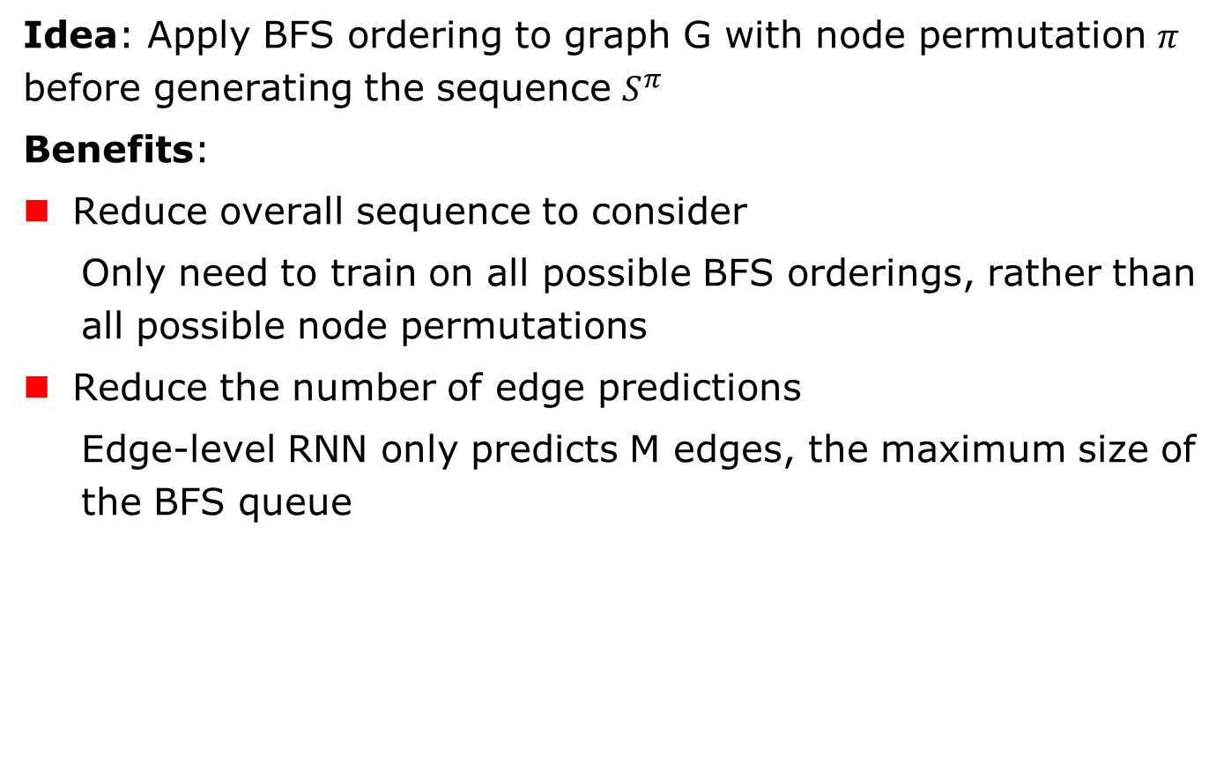
Tractability via Breadth First Search (BFS)
Idea: Apply BFS ordering to graph G with node permutation $π$ before generating the sequence $S^{π}$
Benefits:
Reduce overall sequence to consider
Only need to train on all possible BFS orderings, rather than all possible node permutations
Reduce the number of edge predictions
Edge-level RNN only predicts M edges, the maximum size of the BFS queue

Slide 11
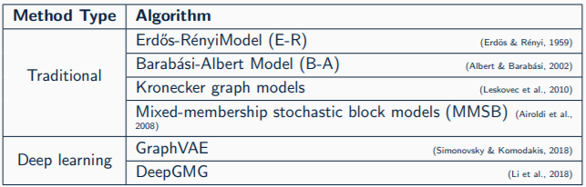
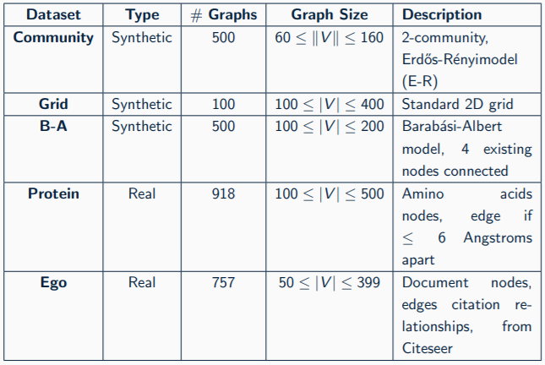
Experiment: Baseline Methods & Datasets

Slide 12
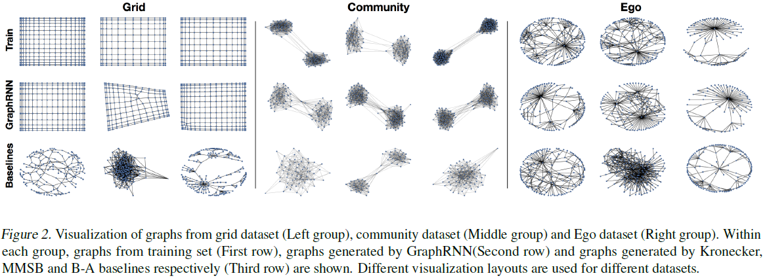
Experiment: Visualization

Slide 13
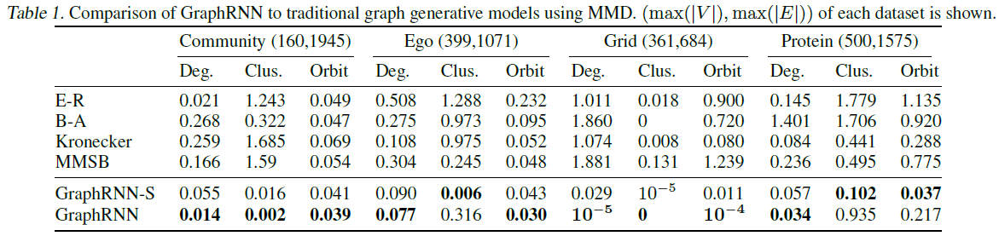
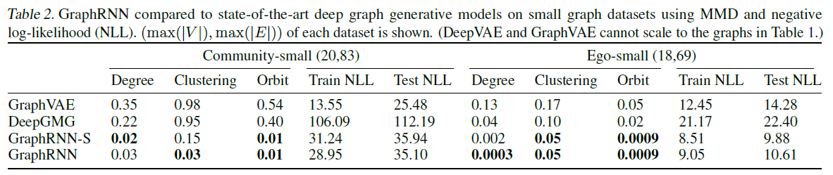
Experiment: Comparison

Slide 14
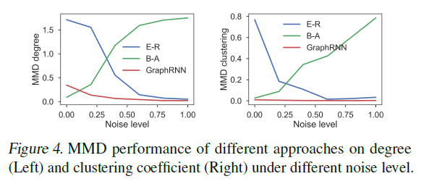
Experiment: Robustness
Interpolate between (B-A) and (E-R) graphs
Randomly perturb [0%, 20%,…, 100%] edges of B-A graphs
0% (B-A) ←----→ 100% (E-R)

Slide 15
GraphGAN
GraphGAN: Graph Representation Learning with Generative Adversarial Nets
Hongwei Wang, JiaWang, JialinWang, Miao Zhao, Weinan Zhang, Fuzheng Zhang, Xing Xie and Minyi Guo
AAAI 2018

Slide 16
GraphGAN: Two categories for representation learning
Most existing methods of graph representation learning can be classified into two categories:
Generative graph representation learning model treats edges as generated from an underlying conditional distribution, e.g., Deepwalk, Node2vec
Discriminative graph representation learning model aims to learn a classifier for predicting the existence of edges directly, e.g., SDNE, PPNE

Slide 17
GraphGAN: Inspiration
LINE has done a preliminary trial on implicitly combining generative and discriminative model (the first-order and the second-order proximity)
GAN has received a great deal of attention by designing a game-theoretical minimax game to combine generative and discriminative models

Slide 18
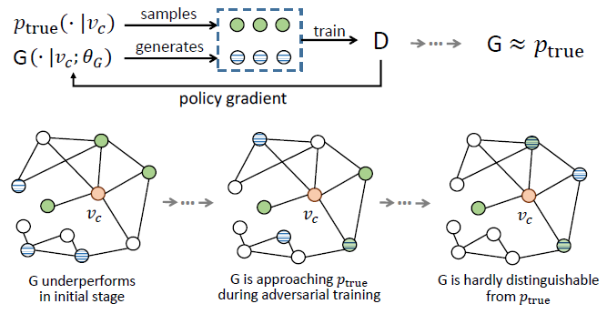
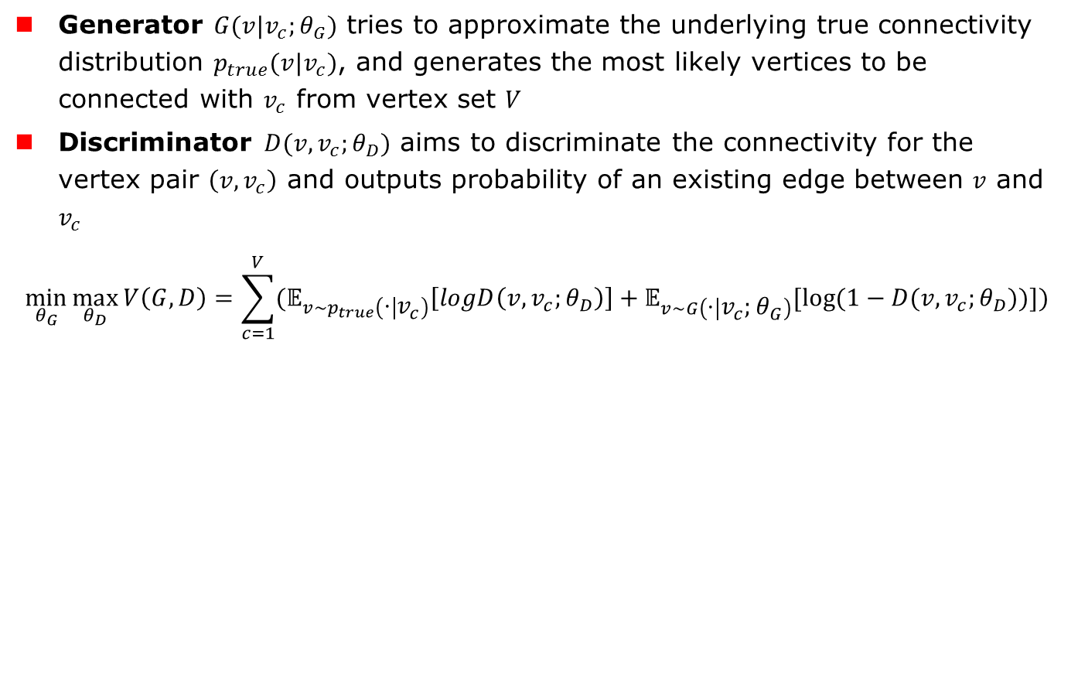
GrapgGAN: Framework
Generator $G(v|v_{c};θ_{G})$ tries to approximate the underlying true connectivity distribution $p_{true}(v|v_{c})$, and generates the most likely vertices to be connected with $v_{c}$ from vertex set $V$
Discriminator $D(v,v_{c};θ_{D})$ aims to discriminate the connectivity for the vertex pair $\left(v, v_{c}\right)$ and outputs probability of an existing edge between $v$ and $v_{c}$
$$\min_{θ_{G}}{\max_{θ_{D}}{V\left(G,D\right)=\sum_{c=1}^{V}{(𝔼_{v\sim p_{true}\left(⋅ | v_{c}\right)}\left[logD\left(v,v_{c};θ_{D}\right)\right]+𝔼_{v\sim G\left(⋅ | v_{c};θ_{G}\right)}[log⁡(1−D(v,v_{c};θ_{D}))])}}}$$

Slide 19
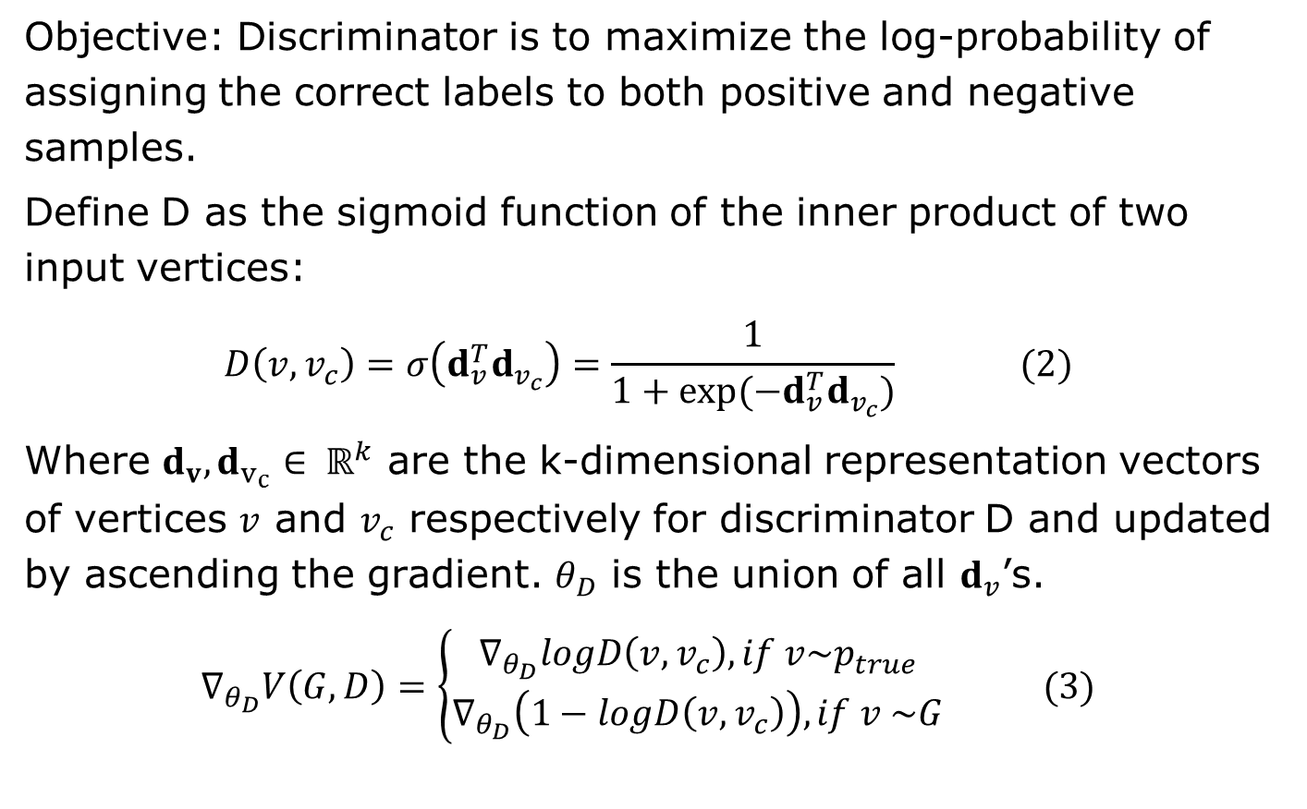
GraphGAN: Discriminator Optimization
Objective: Discriminator is to maximize the log-probability of assigning the correct labels to both positive and negative samples.
Define D as the sigmoid function of the inner product of two input vertices:
$$D\left(v,v_{c}\right)=σ\left(d_{v}^{T}d_{v_{c}}\right)=\frac{1}{1+exp⁡(−d_{v}^{T}d_{v_{c}})} (2)$$
Where $d_{v}, d_{v_{c}}∈ ℝ^{k}$ are the k-dimensional representation vectors of vertices $v$ and $v_{c}$ respectively for discriminator D and updated by ascending the gradient. $θ_{D}$ is the union of all $d_{v}$’s.
$$∇_{θ_{D}}V\left(G,D\right)=\left\{\begin{aligned}∇_{θ_{D}}logD\left(v,v_{c}\right), if v\sim p_{true} \\ ∇_{θ_{D}}\left(1−logD\left(v,v_{c}\right)\right), if v \sim G\end{aligned}\right. (3)$$

Slide 20
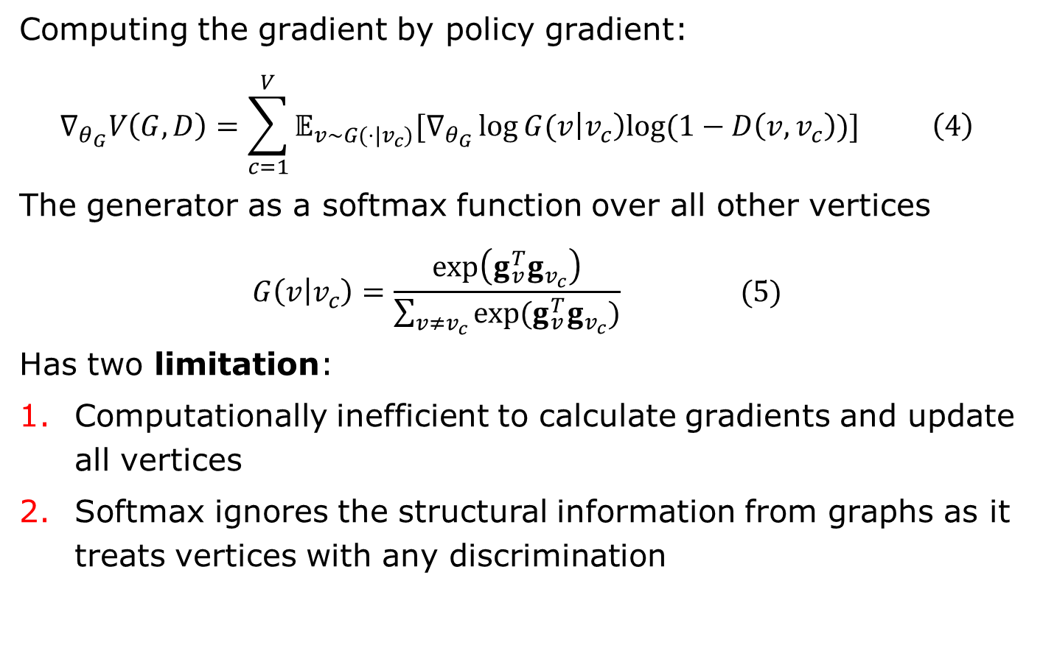
GraphGAN: Generator Optimization
Computing the gradient by policy gradient:
$$∇_{θ_{G}}V\left(G,D\right)=\sum_{c=1}^{V}{𝔼_{v\sim G(⋅|v_{c})}[∇_{θ_{G}}\log{G(v\left|v_{c}\right)log⁡(1−D\left(v,v_{c}\right))}]} \left(4\right)$$
The generator as a softmax function over all other vertices
$$G\left(v | v_{c}\right)=\frac{\exp\left(g_{v}^{T}g_{v_{c}}\right)}{\sum_{v≠v_{c}}{exp⁡(g_{v}^{T}g_{v_{c}})}} (5)$$
Has two limitation:
Computationally inefficient to calculate gradients and update all vertices
Softmax ignores the structural information from graphs as it treats vertices with any discrimination

Slide 21
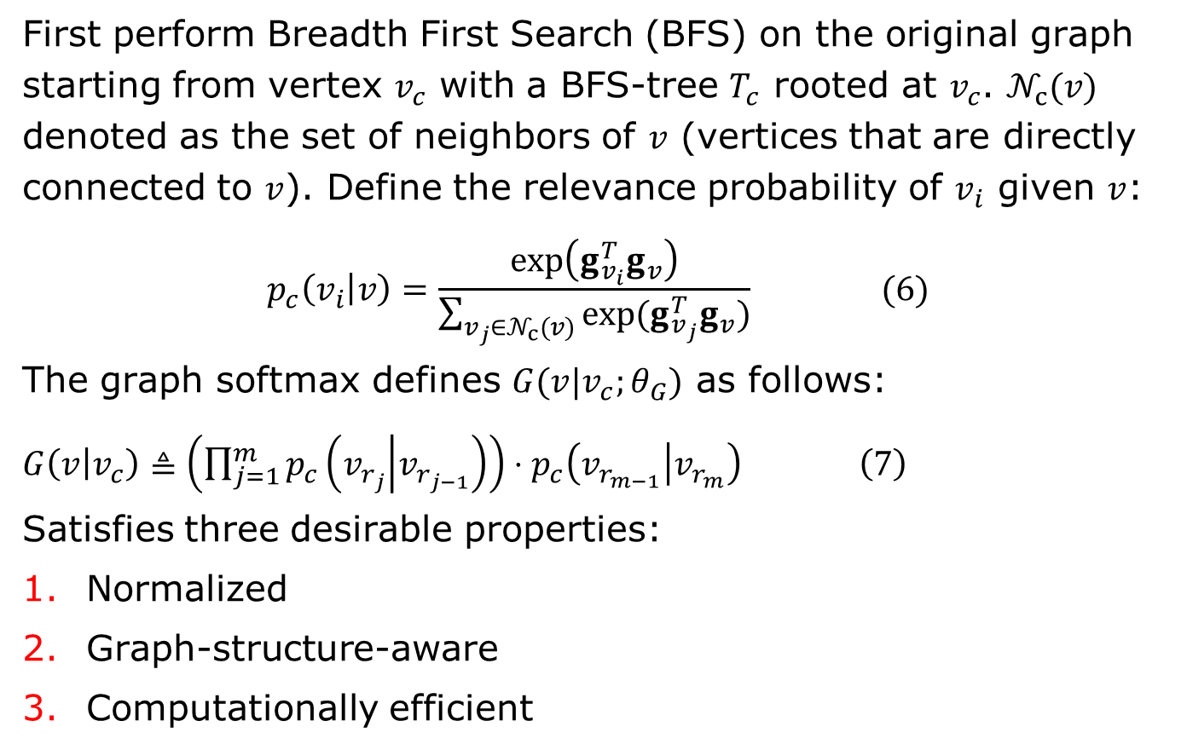
GraphGAN: Graph Softmax for Generator
First perform Breadth First Search (BFS) on the original graph starting from vertex $v_{c}$ with a BFS-tree $T_{c}$ rooted at $v_{c}$. $𝒩_{c}(v)$ denoted as the set of neighbors of $v$ (vertices that are directly connected to $v$). Define the relevance probability of $v_{i}$ given $v$:
$$p_{c}\left(v_{i} | v\right)=\frac{\exp\left(g_{v_{i}}^{T}g_{v}\right)}{\sum_{v_{j}∈𝒩_{c}(v)}{exp⁡(g_{v_{j}}^{T}g_{v})}} (6)$$
The graph softmax defines $G(v|v_{c};θ_{G})$ as follows:
$G\left(v | v_{c}\right)≜\left(\prod_{j=1}^{m}{p_{c}\left(v_{r_{j}} | v_{r_{j−1}}\right)}\right)⋅p_{c}\left(v_{r_{m−1}} | v_{r_{m}}\right) \left(7\right)$
Satisfies three desirable properties:
Normalized
Graph-structure-aware
Computationally efficient

Slide 22
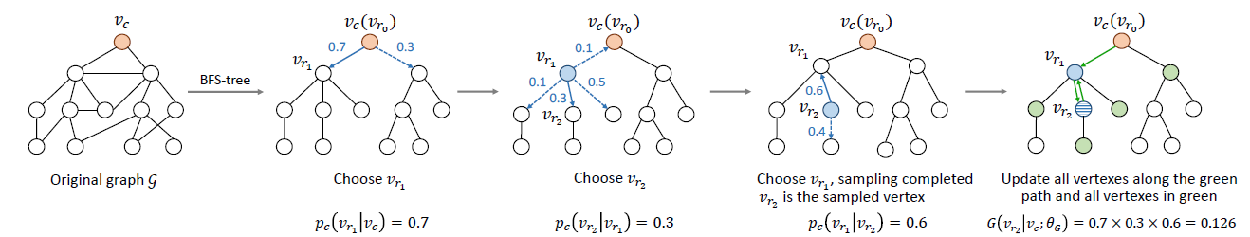
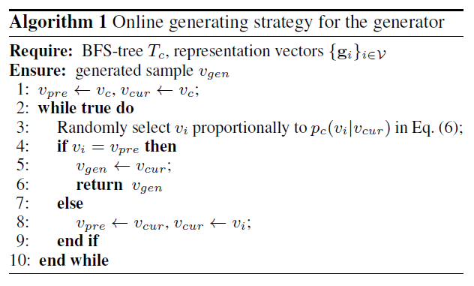
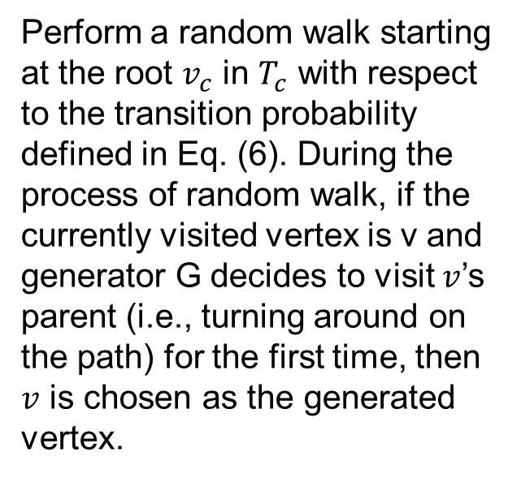
GraphGAN: Generating strategy for G
Perform a random walk starting at the root $v_{c}$ in $T_{c}$ with respect to the transition probability defined in Eq. (6). During the process of random walk, if the currently visited vertex is v and generator G decides to visit $v$’s parent (i.e., turning around on the path) for the first time, then $v$ is chosen as the generated vertex.

Slide 23
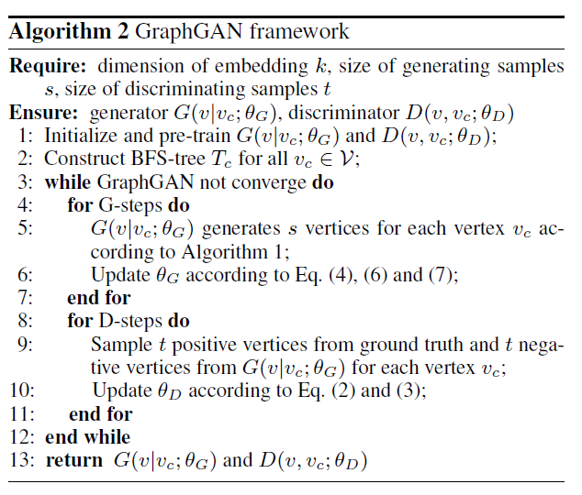
GraphGAN: Algorithm Framework

Slide 24
GraphGAN: Experiment Dataset
Dataset | Content | Vertices # | Edges # | Label #
arXiv-AstroPh | Scientific collaborations between authors with papers | 18,772 | 198,110 | None
arXiv-GrQc | Scientific collaborations between authors with papers | 5,242 | 14,496 | None
BlogCatalog | Network of social relationships of the bloggers | 10,312 | 333,982 | 39
Wikipedia | Co-occurrence network of words | 4,777 | 184,812 | 40
MovieLens-1M | Bipartite graph consisting of movie ratings and users | 3,706 | 6,040 | None

Slide 25
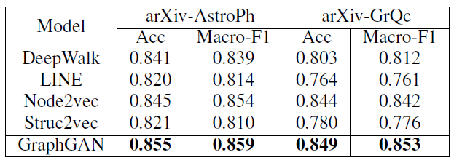
GraphGAN: Link Prediction
We randomly hide 10% of edges in the original graph as ground truth, and use the left graph to train all graph representation learning models.
After training, we obtain the representation vectors for all vertices and use logistic regression method to predict the probability of edge existence for a given vertex pair.

Slide 26
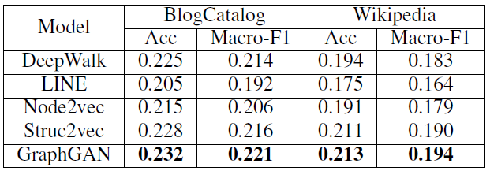
GraphGAN: Node Classification
We train GraphGAN and baselines on the whole graph to obtain vertex representations, and use logistic regression as classifier to perform node classification with 9:1 train-test ratio.

Slide 27
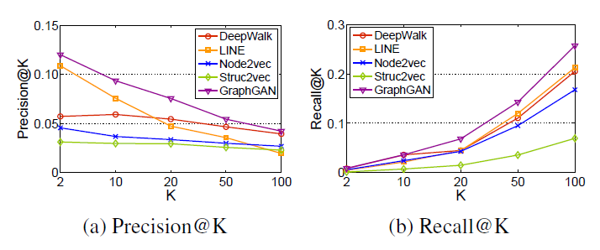
GraphGAN: Recommendation
We first treat all 4-star and 5-star ratings as edges to obtain a bipartite graph, then randomly hide 10% of edges in the original graph as the test set and construct a BFS-tree for each user.

Slide 28
Q & A
THANKS!

